Slide 1
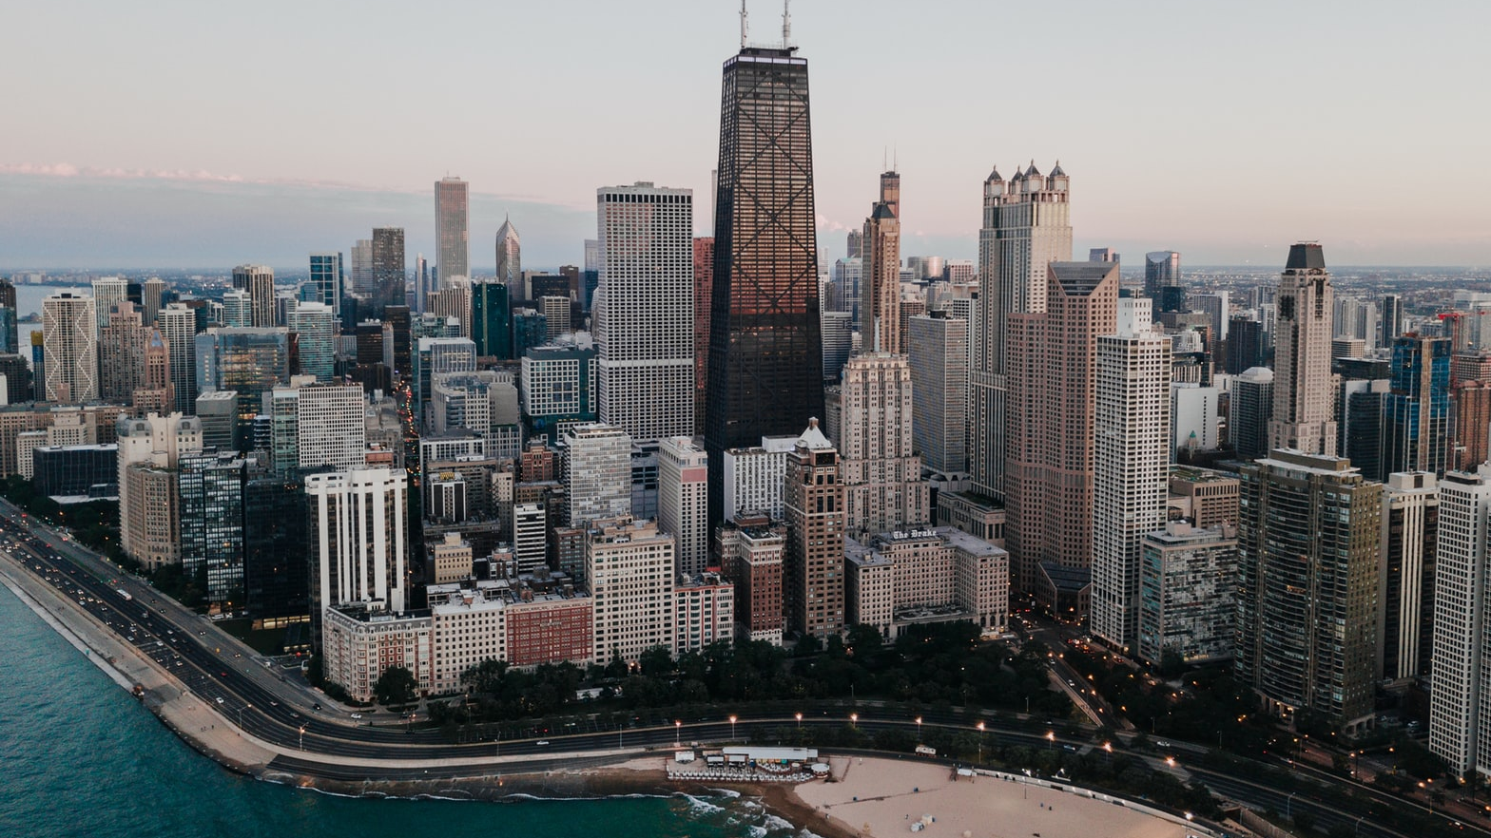
Criminality in Chicago Project Proposal 2019
MDS@FCUP
Vasco Campos
Nuno Costa

Slide 2
Understanding the data
Dataset consisting of over 6 millions entries of registered crimes in the city of Chicago, from 2001 to 2017, divided in 4 chunks.
Exploring features: What is their meaning, how are they distributed over space and time, further derivations .
Notes:
22 features, from date to type of crime and geographic location, that include all types of values (logical, numerical, factos, etc.).
When exploring the dataset we found some columns with missing values that can’t be used, like the ward, community área, and the columns related to the geographic location.

Slide 3
Asking questions
What are the safest areas in Chicago?
How did the safety levels develop with time?
Is the city safer than before?
Are the efforts in mitigating crime being effective and contributing to a safer society?
Is the police focusing on the right things?
Notes:
We started by asking some questions that make the main problem of this project
Next we ask some secondary question

Slide 4
Asking questions
Does crime follow any temporal pattern?
Are police resources sufficient? Can they handle the number of crimes in their section?
Notes:
Specific time of the year where crime drops or peaks?
Does the police actually needs funding? Or are they just allocating their resources inneficiently.

Slide 5
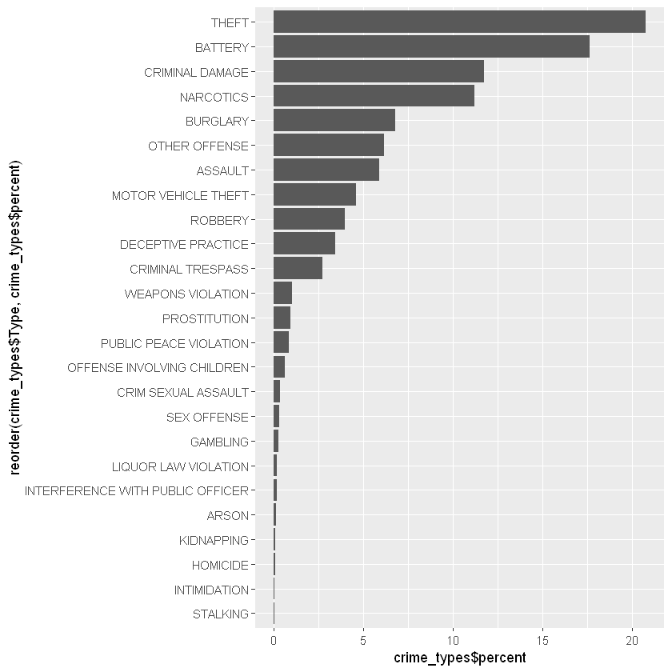

Slide 6
Placing hypothesis
We believe crime has decreased in general terms, but there might be differences across segments.
We believe the police might not be addressing crime types in proportion to their volume/seriousness.
We believe there might be some problems related to police staffing, making them less reactive to simultaneous crimes in the same location.

Slide 7
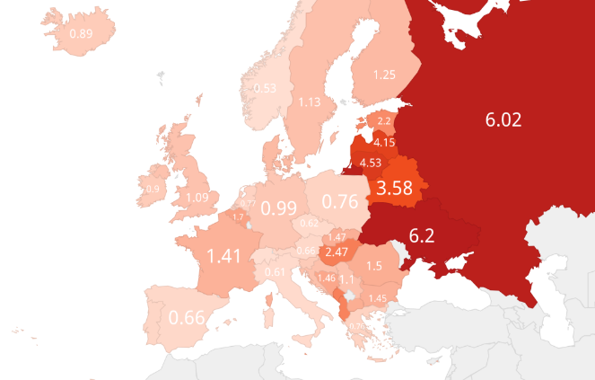
Things found on the internet

Slide 8

Challenges ahead
$${Safety}_{t}\left(place\right)= \frac{\sum{c_{i}}}{\sum{a_{i}c_{i}}}$$
Scaling seriousness of crimes
Modelling a function for safety
Deciding on resolution vs simplicity
Obtaining a good representation through sampling
Transmitting simultaneously the levels of safety for the present and what was their time evolution
And more…
ICCS – International Classification of Crime for Statistical purposes
Sellin-Wolfgang Scale
Notes:
The seriousness of the crimes is the cornerstone of our project so it is very important to define it properly, because we need it to define the safety of a district that will allow us to answer the previous questions.
Scale seriousness of crime according to the ICCS and a few studies about public safety. (Sellin-Wolfgang Scale)
From this model we will try to create a function where we weigh each type of crime according to seriousness, producing a safety function.
Try to maintain the distribution of the population in the sample. (25% of size)

Slide 9
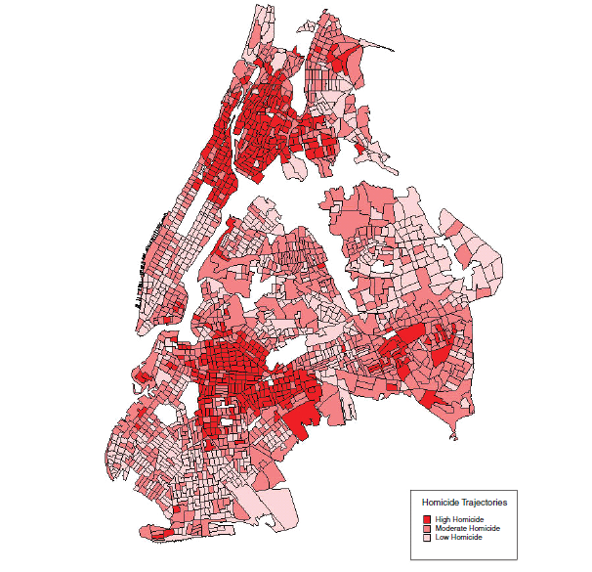
Things found on the internet

